Slide 1
SimplyRhino, London
February 12-14, 2020
Python Scripting for
Rhino/Grasshopper
Long Nguyen

Slide 2
What is actually “stored” inside a variable
a = 2
b = a
b = 3
print a
a = rg.Vector3d(2, 0, 0)
b = a
b.Unitize()
print b
print a

Slide 3
What is actually “stored” inside a variable
a = rg.Vector3d(2, 0, 0)
b = a
b.Unitize()
print b
print a
a
b
rg.Vector3d(2, 0, 0)
rg.Vector3d(1, 0, 0)

Slide 4
What is actually “stored” inside a variable
a = ["Batman"]
b = a
b.append("Spiderman")
print a

Slide 5
How arguments are passed into a function:
import Rhino.Geometry as rg
def DoSomething(someVector):
someVector.Unitize()
myVector = rg.Vector3d(2, 0, 0)
DoSomething(myVector)
print myVector

Slide 6
Tuples

Slide 7
What is a tuple?
A tuple let us pack related data into a single item in a structurally fixed way
Without using tuple
firstName = "John"
lastName = "Clarks"
birthYear = 1988
profession = "Architecture"
Using tuple
john = ("John", "Clarks", 1988, "Architecture")
Here we have a quadruple (a tuple of 4 elements)
Obviously we can also have pairs, triples, quintuple, sextuple, etc…

Slide 8
Retrieve elements from a tuple
john = (“John”, “Clarks”, 1988, “Architecture”)
# Retrive a single element, using the index operator
birthYear = john[2]
print birthYear
print john[-1]
# Retrive a range of elements as a (smaller) tuple, using the slice operator
name = john[0:2]
print name
1988
“Architecture”
(“John”, “Clarks”)

Slide 9
Nested Tuples
Defining tuple-within-tuple
A pair of quadruples
hadid = ("Zaha", "Hadid", 1950, "Architecture")
sanders = ("Bernie", "Sanders", 1941, "Politics")
couple = (sanders, hadid)
print couple[0][1] # This will print "Sanders"

Slide 10
Using tuples as function inputs
hadid = ("Zaha", "Hadid", 1950, "Architecture")
sanders = ("Bernie", "Sanders", 1941, "Politics")
swift = ("Taylor", "Swift", 1989, "Music")
def GetOlderPerson(personA, personB):
if (personA[2] < personB[2]):
return personA
else:
return personB
result1 = GetOlderPerson(hadid, sanders)
result2 = GetOlderPerson(sanders, swift)

Slide 11
Lists vs. Tuples
A list usually stores items of the same type (e.g. strings)
And the items have equivalent “meaning” (e.g. all are names of superheroes)
heroes = ["Batman", "Wolverine", "Superman"]
A tuple can store multiple items of the same or different types
These items “meaningfully” belong to the same entity (e.g. information related to John)
but they often don’t have equivalent meaning (e.g. name has different “meaning” from birthyear)
john = (“John”, “Clarks”, 1988, “Architecture”)

Slide 12
Python in Rhino

Slide 13
Creating Rhino objects

Slide 14
Creating a point object
import Rhino.Geometry as rg
import Rhino
myPoint = rg.Point3d(10, 10, 2)
document = Rhino.RhinoDoc.ActiveDoc
document.Objects.AddPoint(myPoint)
document.Views.Redraw() # Force the viewport to redraw immediately

Slide 15
Saving the GUID of the Rhino object for later use
import Rhino.Geometry as rg
import Rhino
myPoint = rg.Point3d(10, 10, 2)
document = Rhino.RhinoDoc.ActiveDoc
pointObjectGuid = document.Objects.AddPoint(myPoint)
document.Views.Redraw() # Force the viewport to redraw immediately

Slide 16
Creating a line object
import Rhino.Geometry as rg
import Rhino
myPoint = rg.Point3d(10, 10, 2)
document = Rhino.RhinoDoc.ActiveDoc
pointObjectGuid = document.Objects.AddPoint(myPoint)
lineObjectGuid = document.Objects.AddLine(myPoint, rg.Point3d(20, 20, 0))
document.Views.Redraw() # Force the viewport to redraw immediately

Slide 17
RhinoScriptSyntax

Slide 18
Creating a point object, using RhinoScriptSyntax library
Previously, …
import Rhino.Geometry as rg
import Rhino
myPoint = rg.Point3d(10, 10, 2)
document = Rhino.RhinoDoc.ActiveDoc
pointObjectGuid = document.Objects.AddPoint(myPoint)
document.Views.Redraw()
Now, using the RhinoScriptSyntax library instead
import rhinoscriptsyntax as rs
pointObjectGuid = rs.AddPoint(10, 10, 2)

Slide 19
Asking for user’s input

Slide 20
Randomness

Slide 21
Generate random integers
import random
myRandomNumber = random.randint(0, 5)
print myRandomNumber
Generate a random integers
import random
for i in range(0, 10):
myRandomNumber = random.randint(0, 5)
print myRandomNumber
Generate 10 random integers
import random
for i in range(0, 10):
myRandomNumber = random.uniform(1.2, 5.0)
print myRandomNumber
Generate 10 random floats
between 1.2 and 5.0

Slide 22
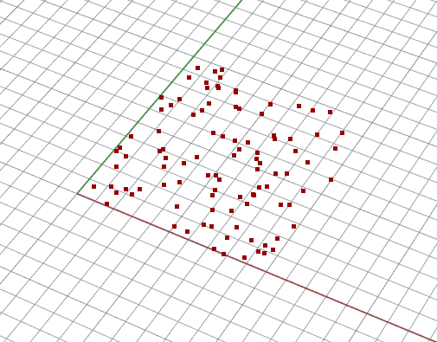
Generate points with random x, y coordinates
INPUTS
iCount: int
OUTPUTS:
oGeometry
import Rhino.Geometry as rg
import random
points = []
for i in range(0, iCount):
x = random.uniform(0.0, 10.0)
y = random.uniform(0.0, 10.0)
point = rg.Point3d(x, y, 0.0)
points.append(point)
oGeometry = points

Slide 23
Randomness does not have to be completely chaotic. We can control randomness in many ways

Slide 24
Randomly offsetting 2D gridpoints
This is the usual 2D grid of points
import Rhino.Geometry as rg
import math
import random
points = []
for i in range(0, 60):
for j in range(0, 30):
x = i
y = j
points.append(rg.Point3d(x , y, 0))
oGeometry = points
INPUTS
iVariation: float
OUTPUTS:
oGeometry

Slide 25
Randomly offsetting grid points
… now let’s add some small random offset from their regular positions
import Rhino.Geometry as rg
import math
import random
points = []
for i in range(0, 60):
for j in range(0, 30):
x = i + random.uniform(-0.1, 0.1)
y = j + random.uniform(-0.1, 0.1)
points.append(rg.Point3d(x , y, 0))
oGeometry = points
INPUTS
iVariation: float
OUTPUTS:
oGeometry

Slide 26
Randomly offsetting grid points
… next, let’s change the amount of offsetting by in external input parameter
import Rhino.Geometry as rg
import math
import random
points = []
for i in range(0, 60):
for j in range(0, 30):
x = i + iVariation * random.uniform(-1.0, 1.0)
y = j + iVariation * random.uniform(-1.0, 1.0)
points.append(rg.Point3d(x , y, 0))
oGeometry = points
INPUTS
iVariation: float
OUTPUTS:
oGeometry

Slide 27
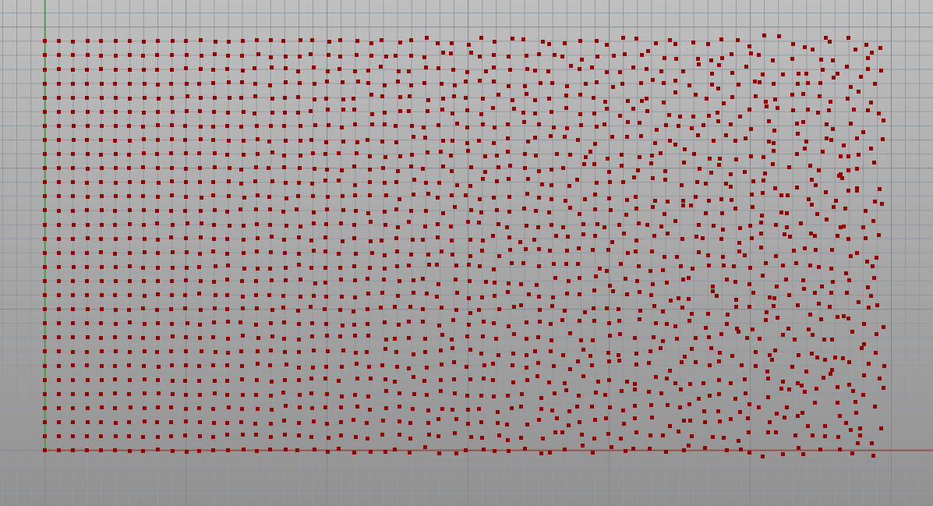
How about this: Transition from no variation to maximum variation

Slide 28
Transition from “regular” to “random”
import Rhino.Geometry as rg
import math
import random
points = []
for i in range(0, 60):
for j in range(0, 30):
variation = 0.5 * (i / 59)
x = i + variation * random.uniform(-1.0, 1.0)
y = j + variation * random.uniform(-1.0, 1.0)
points.append(rg.Point3d(x , y, 0))
oGeometry = points

Slide 29
Colors

Slide 30
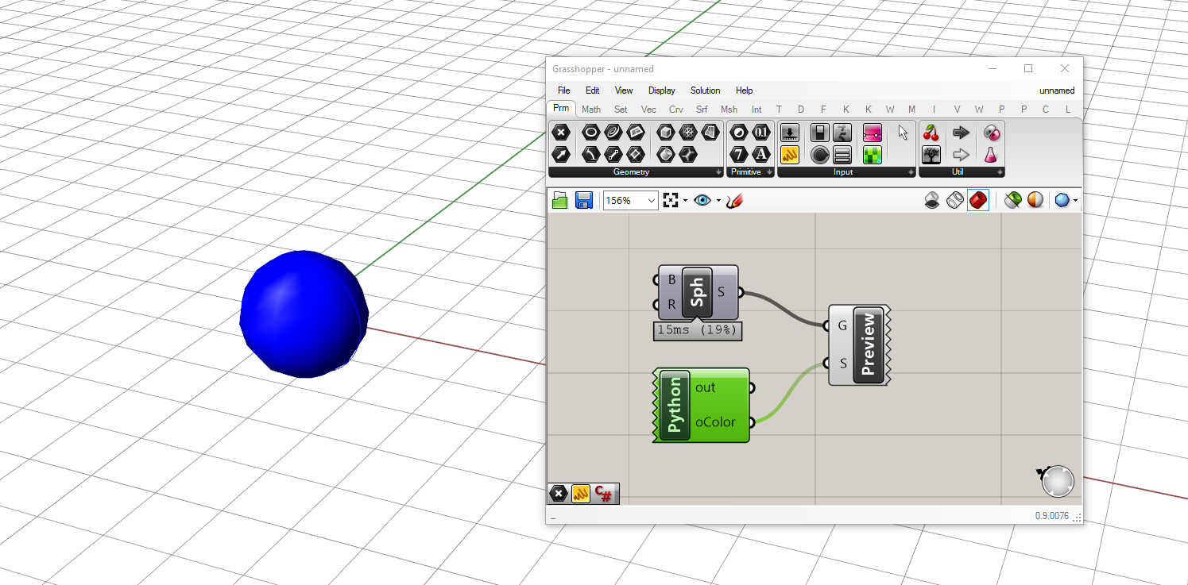
Creating Color using Python
import System.Drawing as drawing
oColor = drawing.Color.FromArgb(0, 0, 255)

Slide 31
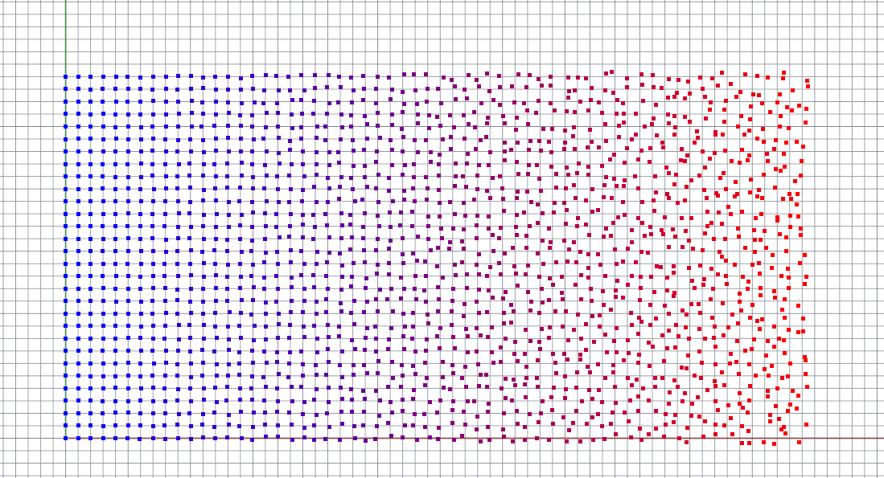
Control colors algorithmically

Slide 32
Control colors algorithmically
import Rhino.Geometry as rg
import math
import random
import System.Drawing as drawing
points = []
colors = []
for i in range(0, 60):
for j in range(0, 30):
variation = 0.5 * (i / 59)
x = i + variation * random.uniform(-1.0, 1.0)
y = j + variation * random.uniform(-1.0, 1.0)
points.append(rg.Point3d(x , y, 0))
red = 255 * i / 59
blue = 255 - red
color = drawing.Color.FromArgb(red, 0, blue)
colors.append(color)
oGeometry = points
oColor = colors

Slide 33
Parametric Curves Creating curves

Slide 34
Creating NurbsCurve: Interpolated Curve
INPUTS
iPoints: List of Point3d
OUTPUTS:
oCurve
import Rhino.Geometry as rg
oCurve = rg.Curve.CreateInterpolatedCurve(iPoints, 3)

Slide 35
Creating NurbsCurve: Control Point Curve
INPUTS
iPoints: List of Point3d
OUTPUTS:
oCurve
import Rhino.Geometry as rg
oCurve = rg.Curve.CreateControlPointCurve(iPoints, 3)

Slide 36
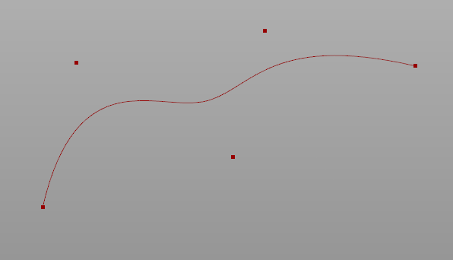
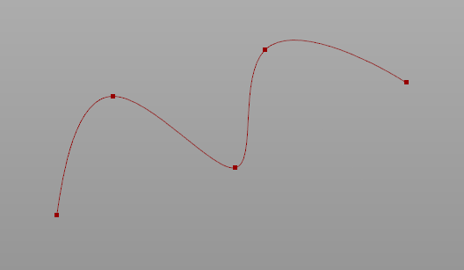
Control Point Curve vs. Interpolated Curve
Control Point Curve
(Approximated Curve)
Interpolated Curve
(Live demonstration of twisting issues and tangent line up)

Slide 37
Curve Degree
Higher curve degree gives smoother curve
Higher curve degree means each point on the curve is influenced by more control points
Why degree 3 is usually the default value?
(Live demonstration)

Slide 38
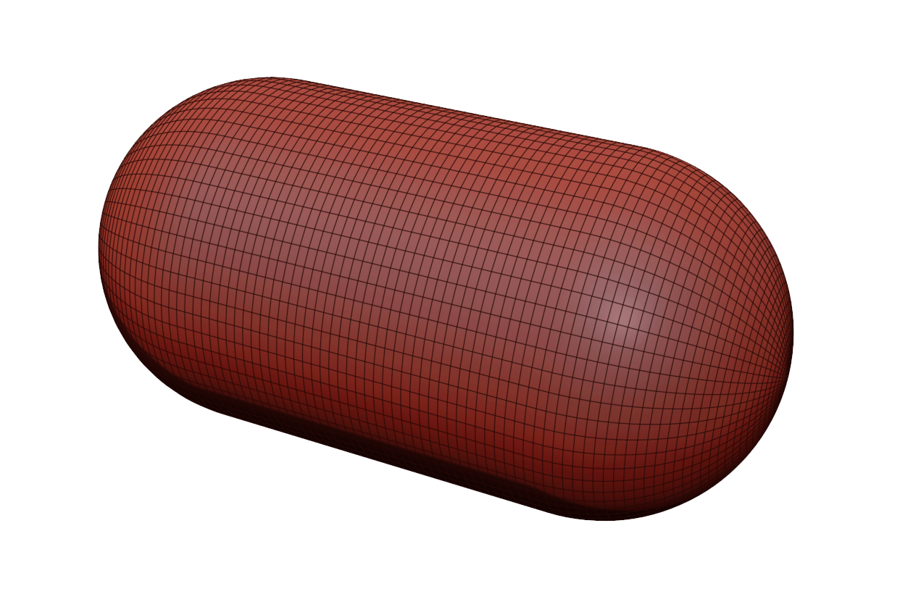
Why degree 3 is usually the default?
Degree 2 is smooth, but not smooth enough

Slide 39
Why degree 3 is usually the default?
Degree 2 is smooth, but not smooth enough

Slide 40
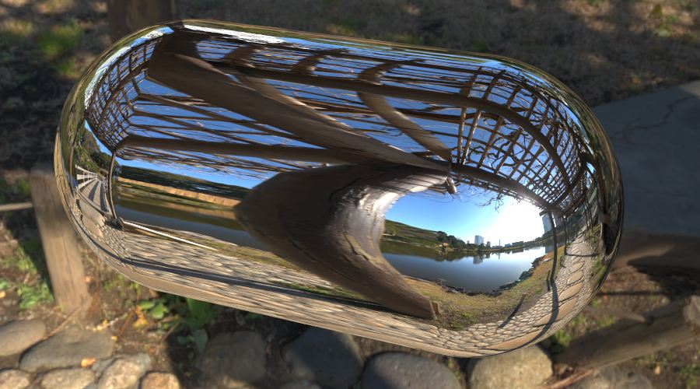
Why degree 3 is usually the default?
Degree 2 is smooth, but not smooth enough

Slide 41
Creating Curves: LineCurve
import Rhino.Geometry as rg
myLineCurve = rg.LineCurve(rg.Point3d(0,0,0), rg.Point3d(3, 4, 5))
Why Rhino has Line and also LineCurve? What’s the difference?

Slide 42
Curves Curve operations

Slide 43
Evaluate points along a curve
Each point on a parametric curve is uniquely correspondent to a number, known as “curve parameter”
point = iCurve.PointAt(iCurveParameter)
oGeometry = point
INPUTS
iCurve: Curve
iCurveParameter: float
OUTPUTS:
oGeometry

Slide 44
Other common curve operations
# Get the point on the curve at the specified distance from the starting point of the curve
PointAtLength(float) -> Point3d
# Get the local coordinate frame associated with the point at the specified curve parameter
FrameAt(float) -> (bool, Plane)
# Get the closest point on the curve relative to the input point
ClosestPoint(Point3d) -> (bool, float)

Slide 45
C# Functions → Python functions
In a C#, if a function needs to return more than one outputs, it will store the additional outputs in the “out” parameters
C#
ClosestPoint(Point3d, out double) → bool
In Python, if a function needs to return more than one outputs, it will group all output into a tuple and return that tuple
Python
ClosestPoint(Point3d) → (bool, float)

Slide 46
Parametric Surfaces Operations on parametric surfaces

Slide 47
Parametric surface
Parametric surface is a collection of points, each has its own (u, v) coordinates
Naturally, an (untrimmed) parametric surface has 4 boundary sides
Parametric surface has a “positive” side and “negative” side
(Live Demonstration)

Slide 48
Evaluate points on the surface
Each point on a parametric surface is uniquely correspondent to a pair of numbers (u, v)
import Rhino.Geometry as rg
iSurface.SetDomain(0, rg.Interval(0.0, 1.0))
iSurface.SetDomain(1, rg.Interval(0.0, 1.0))
point = iSurface.PointAt(iU , iV)
oGeometry = point
INPUTS
iSurface: Surface
iU: float
iV: float
OUTPUTS:
oGeometry

Slide 49
Other common operations
# Get the local coordinate frame associated with the point at the specified (u, v) coordinates
FrameAt(float, float) -> (bool, Plane)
# Get the closest point on the curve relative to the input point
ClosestPoint(Point3d) -> (bool, float, float)
# IMPORTANT: Compute an iso-curve of the surface
IsoCurve(int, float) -> Curve

Slide 50
Live Exercise Parametric pyramid

Slide 51
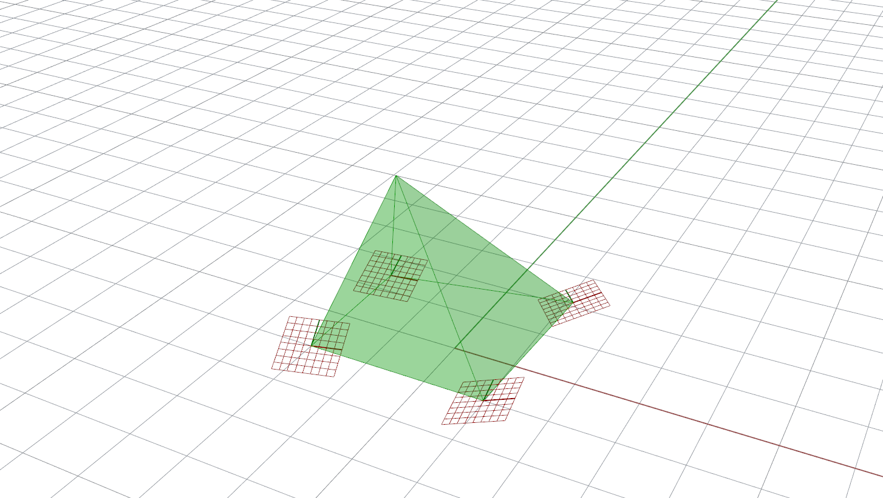
Input: 4 planes (coordinate frames)
Output: a pyramid (as 4 parametric surfaces) whose top is pointing in the direction that is the average of the Z axes of 4 planes

Slide 52
A utitlity function: Create a surface from three points
import Rhino.Geometry as rg
def CreateTriangleSurface(A, B, C):
CB = rg.LineCurve(C, B)
BA = rg.LineCurve(B, A)
AC = rg.LineCurve(A, C)
return rg.Brep.CreateEdgeSurface([CB, BA, AC])
oGeometry = CreateTriangleSurface(iA, iB, iC)

Slide 53
import Rhino.Geometry as rg
def CreateTriangleSurface(A, B, C):
CB = rg.LineCurve(C, B)
BA = rg.LineCurve(B, A)
AC = rg.LineCurve(A, C)
return rg.Brep.CreateEdgeSurface([CB, BA, AC])
def CreateComponentSurfaces(frameA, frameB, frameC, frameD, height):
z = frameA.ZAxis + frameB.ZAxis + frameC.ZAxis + frameD.ZAxis
z.Unitize()
centerBottom = 0.25 * (frameA.Origin + frameB.Origin + frameC.Origin + frameD.Origin)
top = centerBottom + height * z
surface1 = CreateTriangleSurface(frameA.Origin, frameB.Origin, top)
surface2 = CreateTriangleSurface(frameB.Origin, frameC.Origin, top)
surface3 = CreateTriangleSurface(frameC.Origin, frameD.Origin, top)
surface4 = CreateTriangleSurface(frameD.Origin, frameA.Origin, top)
return [surface1, surface2, surface3, surface4]
oGeometry = CreateComponentSurfaces(iFrameA, iFrameB, iFrameC, iFrameD, 3.0)

Slide 54
Live Exercise Adaptive geometry along a uv-surface

Slide 55
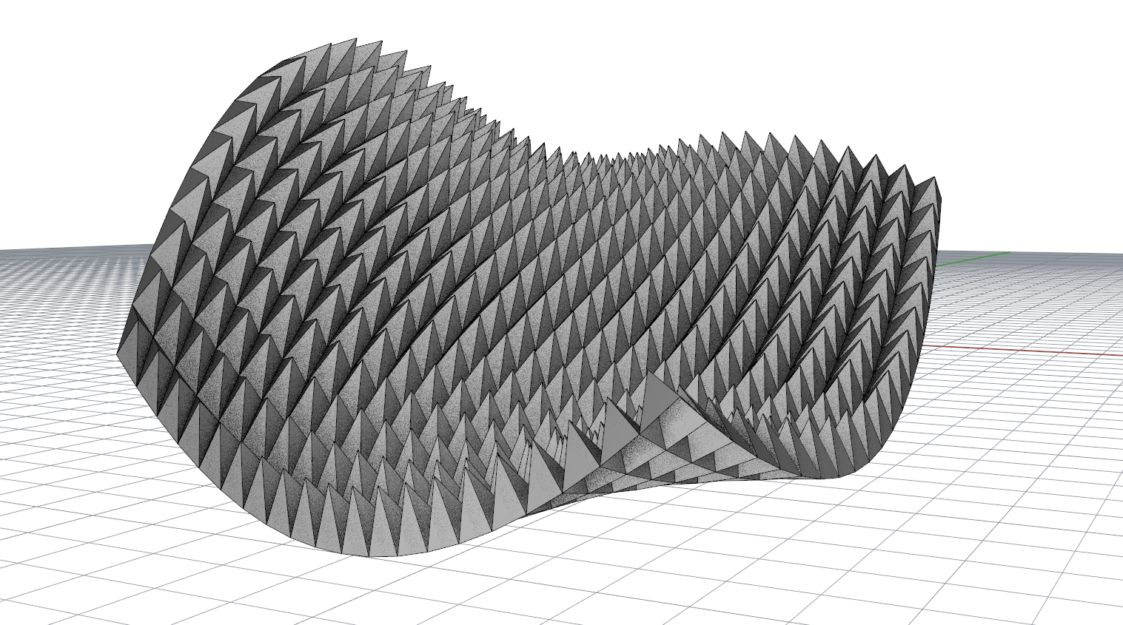

Slide 56
import Rhino.Geometry as rg
def CreateTriangleSurface(A, B, C):
...
def CreateComponentSurfaces(frameA, frameB, frameC, frameD, height):
...
iSurface.SetDomain(0, rg.Interval(0.0, 1.0))
iSurface.SetDomain(1, rg.Interval(0.0, 1.0))
allSurfaces = []
for i in range(0, iUDivision):
for j in range(0, iVDivision):
frameA = iSurface.FrameAt(i / iUDivision, j / iVDivision)[1]
frameB = iSurface.FrameAt((i + 1) / iUDivision, j / iVDivision)[1]
frameC = iSurface.FrameAt((i + 1) / iUDivision, (j + 1) / iVDivision)[1]
frameD = iSurface.FrameAt(i / iUDivision, (j + 1) / iVDivision)[1]
componentSurfaces = CreateComponentSurfaces(frameA, frameB, frameC, frameD, 1.5)
allSurfaces.extend(componentSurfaces)
oGeometry = allSurfaces

Slide 57
Breps

Slide 58
Brep
Brep is a collection of (optionally trimmed) surfaces
# Assume that myBrep is a variable that stores an object of data type Brep
# Get the number of surfaces that contained inside the brep object
print myBrep.Surfaces.Count
# Retrieve a specific surface from the brep
mySurface = myBrep.Surfaces[0]

Slide 59
Brep: Create loft surfaces
Brep is a collection of (optionally trimmed) surfaces
import Rhino.Geometry as rg
# Assume that myCurves is a list of objects of type Curve
breps = rg.Brep.CreateFromLoft(myCurves, rg.Point3d.Unset, rg.Point3d.Unset, \ rg.LoftType.Normal, False)
# The static method CreateFromLoft actually returns an array of Brep objects
# If we are confident that we will get only one brep, which contains only one surface, ... # ... then we can retrieve that surface using the square-bracket operator
myLoftSurface = breps[0].Surfaces[0]

Slide 60
Meshes

Slide 61
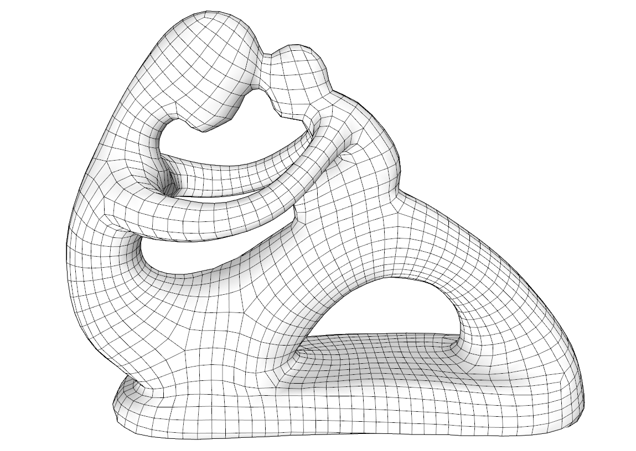
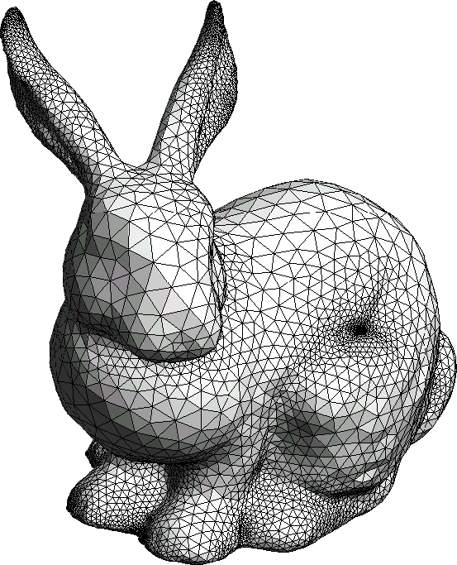
What is a mesh?
Mesh is a general way to describe arbitrary 3D shape using ONLY polygons
A mesh can contains only triangular faces, quad faces, or polygonal faces, or a mixture of these things
Note: smooth shading can be applied on a mesh so that it appears to be smooth when being displayed/rendered. But the underlying geometry is still polygonal (which is usually evident when looking at the silhouette of the model)

Slide 62
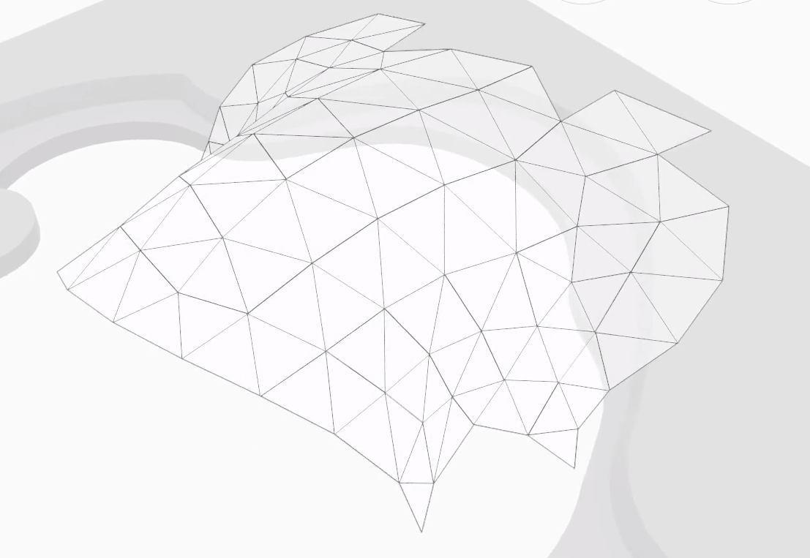
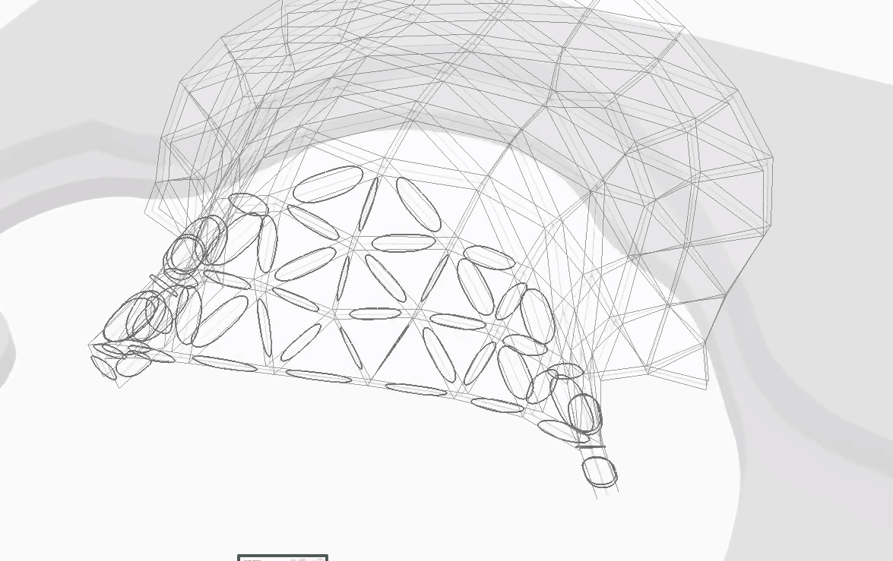
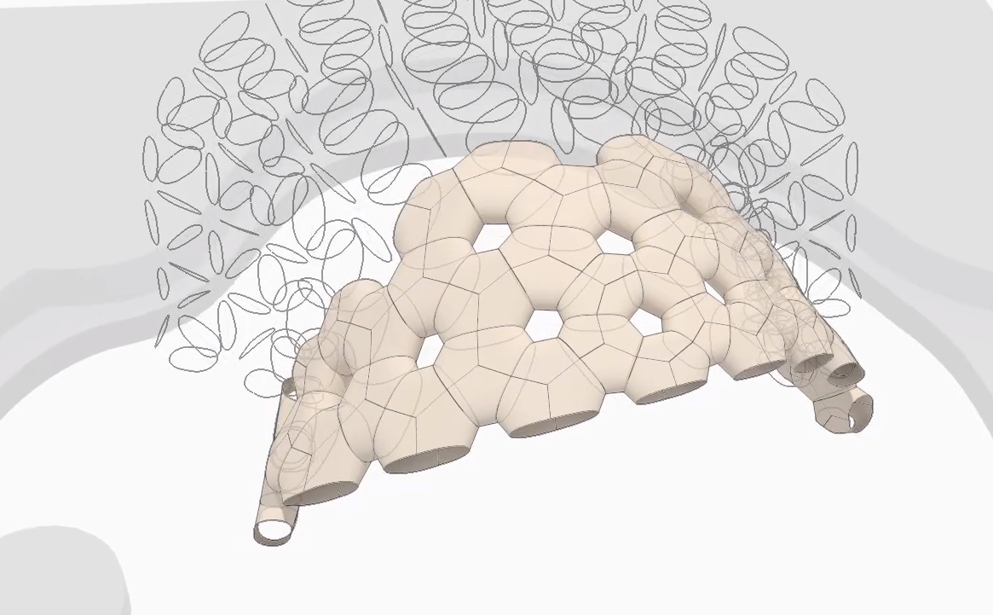
Mesh in computational design
In computational design, meshes are useful not only because they can describe arbitrary shapes. But also because they explicitly contains topological information (which vertex connects to which vertex), which makes them a good tool for certain kinds of computational design logic (e.g. panels, truss, plates, etc.)
ICD/ITKE Research Pavilion 2015-2016
Triangular mesh
Generate intermediate geometries based on the triangular faces and their inter-relationship
Generate final architectural design geometries

Slide 63
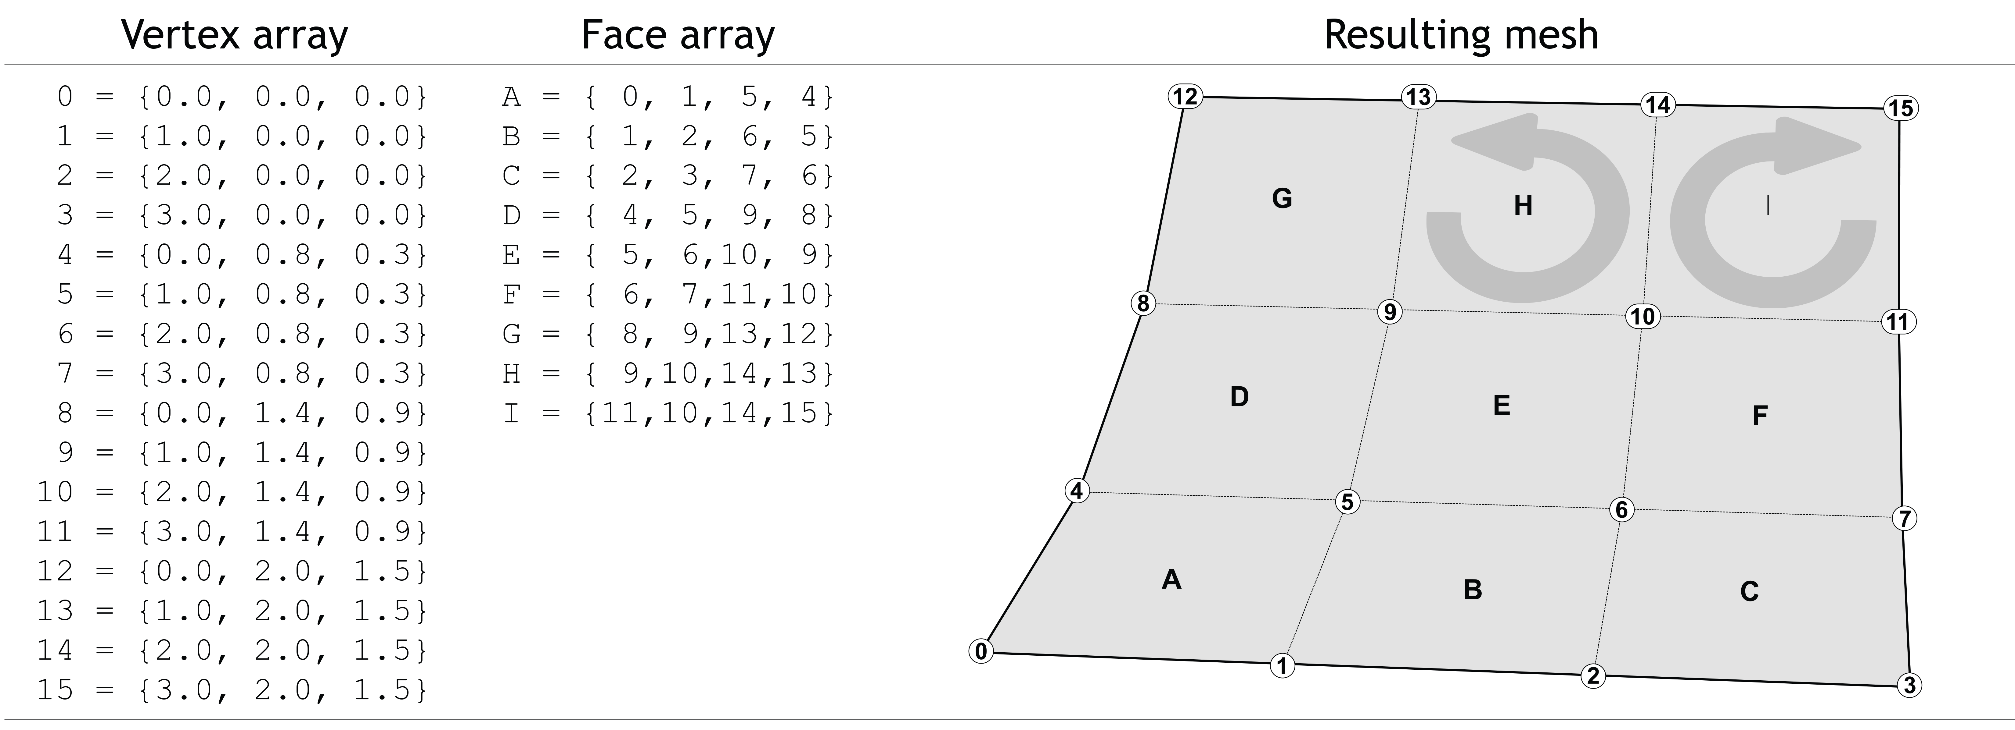
Meshes in Rhino
In Computer Graphics, there exist many methods and variations to describe a mesh. Rhino uses one of these.
A (Rhino) mesh contains:
A list of vertices (each of which is a Point3f object)
A list of MeshFace objects, each of which contains three (or four) integers that specify the indices of the vertices that make up the triangular (or quad) face.
The sidedness of each face on the order of the vertices (clockwise vs. counter-clockwise)

Slide 64
Example: Creating a mesh from scratch
Please open file TetrahedronMesh.gh
import Rhino.Geometry as rg
mesh = rg.Mesh() # Create an empty Mesh object
# Manually add the vertices
mesh.Vertices.Add(iA)
mesh.Vertices.Add(iB)
mesh.Vertices.Add(iC)
mesh.Vertices.Add(iD)
# Manually add the faces
mesh.Faces.AddFace(2, 1, 0) # C, B, A
mesh.Faces.AddFace(0, 1, 3) # A, B, D
mesh.Faces.AddFace(1, 2, 3) # B, C, D
mesh.Faces.AddFace(2, 0, 3) # C, A, D
oMesh = mesh
INPUTS:
iA, iB, iC, iD: Point3d
OUTPUTS:
oMesh
D
C
A
B

Slide 65
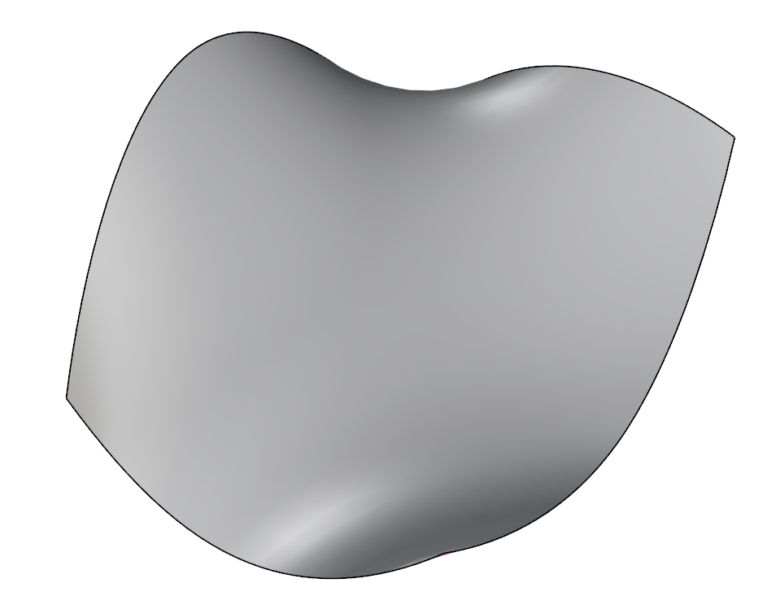
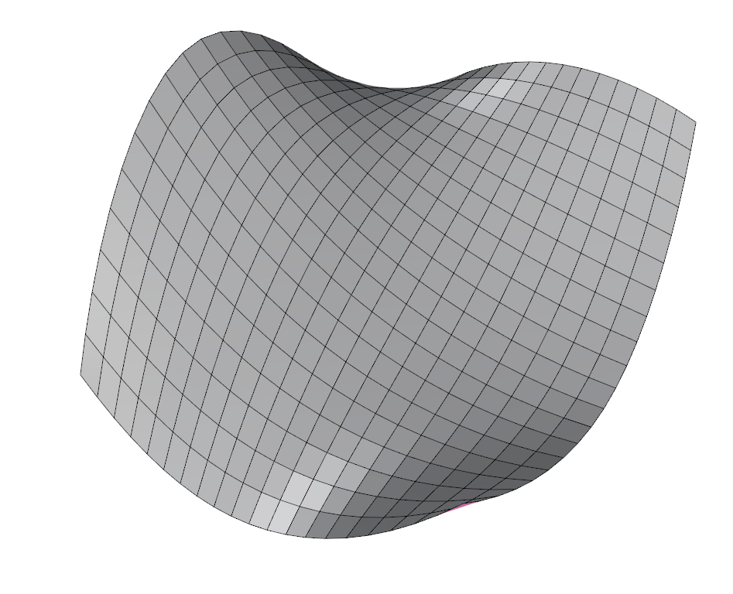
Example: Create a mesh based on a UV surface
We can build a mesh from a UV surface
The mesh vertices are based on a 2D grid, on the UV-coordinates of the surface
(We did this routine in the previous lecture)
Tip: Turn on Flat Shading to clearly see the polygonal faces of the result quad mesh!

Slide 66
Example: Create a mesh based on a UV surface
import Rhino.Geometry as rg
iSurface.SetDomain(0, rg.Interval(0.0, 1.0))
iSurface.SetDomain(1, rg.Interval(0.0, 1.0))
mesh = rg.Mesh() # First, Create an empty mesh object
# Create vertices for the mesh
for i in range(0, iUDivision + 1):
for j in range(0, iVDivision + 1):
u = i / iUDivision
v = j / iVDivision
mesh.Vertices.Add(iSurface.PointAt(u, v))
# This utility function compute the vertex index knowing the row and column indices
def GerVertexIndex(i, j):
return i * (iVDivision + 1) + j
# Create the mesh faces. For each face, we need to obtain the indices of the four relevant vertices
for i in range(0, iUDivision):
for j in range(0, iVDivision):
v1 = GerVertexIndex(i, j)
v2 = GerVertexIndex(i + 1, j)
v3 = GerVertexIndex(i + 1, j + 1)
v4 = GerVertexIndex(i, j + 1)
mesh.Faces.AddFace(v1, v2, v3, v4)
oGeometry = mesh # Finally, output the mesh, yay!!!
Please open file
UVSurfaceToMesh.gh
INPUTS:
iSurface: Surface
iUDivision: int
iVDivision: int
OUTPUTS:
oGeometry

Slide 67
The previous example shows how to create a quad mesh from the UV surface
Quick exercise to do in class:
Modify the Python codes so that it produce a triangular mesh instead
(Note: there are more than one way to generate triangular pattern on the surface)

Slide 68
Vertex Normals

Slide 69
Vertex normals
vertex normal
vertex normal
face normal
face normal
face normal
Each mesh face has a normal vector, obviously
But we can also define a normal vector for each vertex too
A vertex normal is the average of the surrounding face normals
A vertex normal approximates the orientation of the surface (recall that a mesh is a discreet way to represent a continuous, usually smooth surface)
(Just FYI, The smooth shading algorithm uses the vertex normals to make the surface appear smooth when displayed)

Slide 70
Compute the vertex normals
Usually, vertex normals are computed automatically
If vertex normals are not available. We can simply invoke the function ComputeNormals once
We can access the normal (which is a Vector3f object) of each vertex using the square-bracket operator
myMesh.Normals.ComputeNormals()
firstVertexNormal = myMesh.Normals[1]

Slide 71
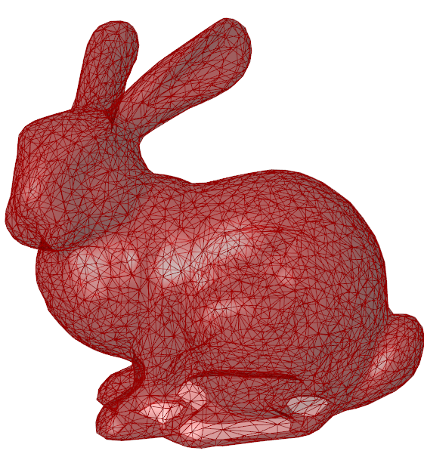
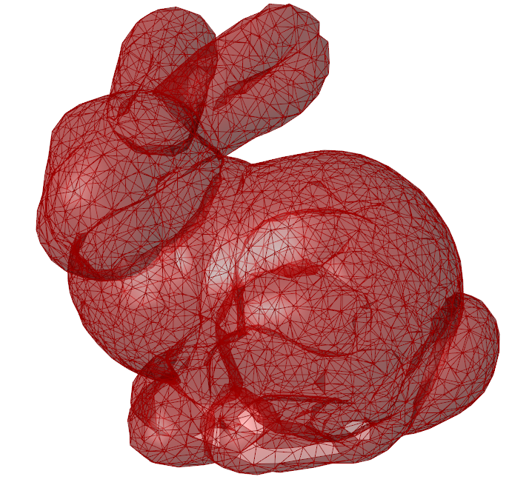
Example: Inflate a mesh
Inflate the Stanford bunny mesh by offsetting each vertex along its normal vector by a pre-specified amount

Slide 72
Example: Inflate a mesh
Please open file
InflateMesh.gh
INPUTS:
iMesh: Mesh
iInflateDistance: float
OUTPUTS:
oGeometry
import Rhino.Geometry as rg
for i in range(iMesh.Vertices.Count):
# Notice that we have to "convert" from Point3f to Point3d
position = rg.Point3d(iMesh.Vertices[i])
# Notice that we have to "convert" from Vector3f to Vector3d
normal = rg.Vector3d(iMesh.Normals[i])
# The reason for the "conversion" is because Point3f and Vector3d does not support math operators (e.g. + or *)
newPosition = position + normal * iInflateDistance
iMesh.Vertices.SetVertex(i, newPosition)
oGeometry = iMesh

Slide 73
Vertex Colors

Slide 74
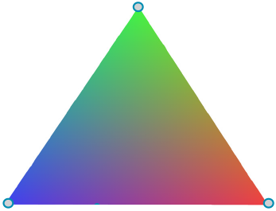
We can assign a color to each vertex
A triangular faces will be colored by blending the colors of the three vertices, resulting in overall smooth color gradient across the face.

Slide 75
Example: Assign random colors to mesh vertices
Please open file
VertexColors.gh
import Rhino.Geometry as rg
from System.Drawing import Color
import random
for i in range(iMesh.Vertices.Count):
red = random.uniform(0, 255)
green = random.uniform(0, 255)
blue = random.uniform(0, 255)
randomColor = Color.FromArgb(255, red, green, blue)
iMesh.VertexColors.SetColor(i, randomColor)
oMesh = iMesh
INPUTS:
iMesh: Mesh
OUTPUTS:
oMesh

Slide 76
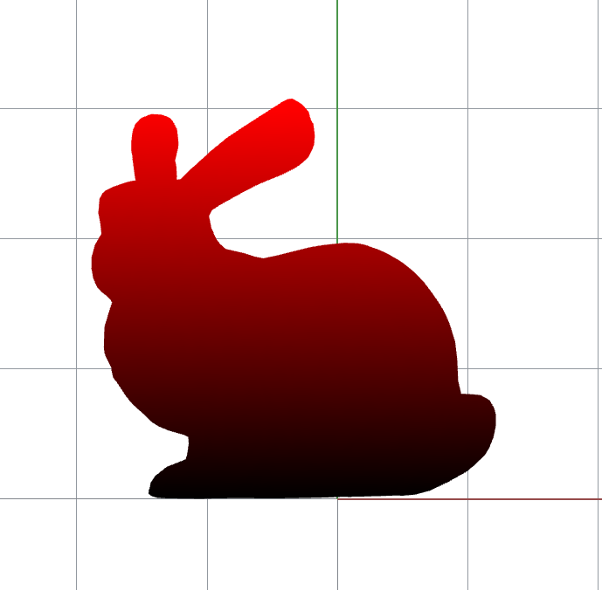
5-minute exercise: Assigning vertex colors based on z-coordinates

Slide 77
Mesh Topology

Slide 78
Example: Mesh smoothing
Key Idea: Move each vertex toward the AVERAGE of all the neighbor vertices

Slide 79
Example: Mesh smoothing
import Rhino.Geometry as rg
for k in range(iIterations):
smoothMesh = rg.Mesh()
for face in iMesh.Faces:
smoothMesh.Faces.AddFace(face)
for i in range(iMesh.Vertices.Count):
neighborIndices = iMesh.TopologyVertices.ConnectedTopologyVertices(i)
averageOfNeighbors = rg.Point3d(0.0, 0.0, 0.0)
for j in neighborIndices:
averageOfNeighbors += rg.Point3d(iMesh.Vertices[j])
averageOfNeighbors /= len(neighborIndices);
smoothVertex = 0.5 * rg.Point3d(iMesh.Vertices[i]) + 0.5 * averageOfNeighbors
smoothMesh.Vertices.Add(smoothVertex)
iMesh = smoothMesh;
oSmoothMesh = iMesh;

